Slide 1
shear

Slide 2
introduction
A CONCRETE BEAM SUBJECT TO A LARGE LOAD NEAR THE SUPPORTS MAY FAIL AS A RESULT OF SHEAR.
SHEAR FAILURES ARE CHARACTERISED BY SMALL DEFLECTIONS AND LACK OF DUCTILITY.
THE DESIGN SHEAR FORCE, V_{Ed}, IS NORMALLY DETERMINED AT A DISTANCE ‘d’ FROM THE FACE OF SUPPORTS.

Slide 3
SHEAR STRENGTH
THE SHEAR STRENGTH OF A REINFORCED CONCRETE BEAM IS A FUNCTION OF
CONCRETE IN THE COMPRESSION ZONE
AGGREGATE INTERLOCK
DOWELL ACTION

Slide 4
SHEAR RESISTANCE OF CONCRETE
THE DESIGN SHEAR RESISTANCE OF THE CONCRETE ALONE, V_{Rd,c}, IS GIVEN BY
V_{Rd,c} = [C_{Rd,c} k (100ρ₁f_{ck})^{⅓} + k₁σ_{cp})b_{w}d ≥ (ν_{min} + k₁σ_{cp})b_{w}d ------(1) (Expression 6.2a/b)
where
C_{Rd,c} = 0.18/γ_{C}
k = 1 + √(200/d) ≤ 2.0
ρ₁ = A_{sl}/bd
A_{sl} is the area of the tensile reinforcement
σ_{cp} = N_{Ed}/A_{c} ≤ 0.2f_{cd}, in which N_{Ed} is the axial force in the x-section
ν_{min} = 0.035k^{3/2}f_{ck}^{1/2}

Slide 5
Design criterion
IF V_{Ed} < V_{Rd,c} - THE MEMBER SHOULD NOT EXPERIENCE SHEAR FAILURE
IF V_{Ed} > V_{Rd,c} - SHEAR FAILURE IS A POSSIBILITY

Slide 6
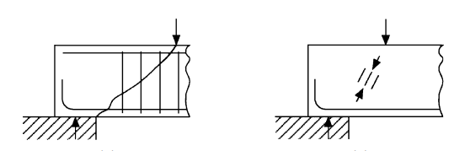
MECHANISMS OF SHEAR FAILURE
THERE ARE TWO PRINCIPAL MECHANISMS OF SHEAR FAILURE
(i) DIAGONAL TENSION – PREVENTED BY PROVIDING SHEAR REINFORCEMENT
(ii) DIAGONAL COMPRESSION – PREVENTED BY CHECKING THE SHEAR RESISTANCE OF THE CONCRETE IS ADEQUATE
(i) (ii)

Slide 7
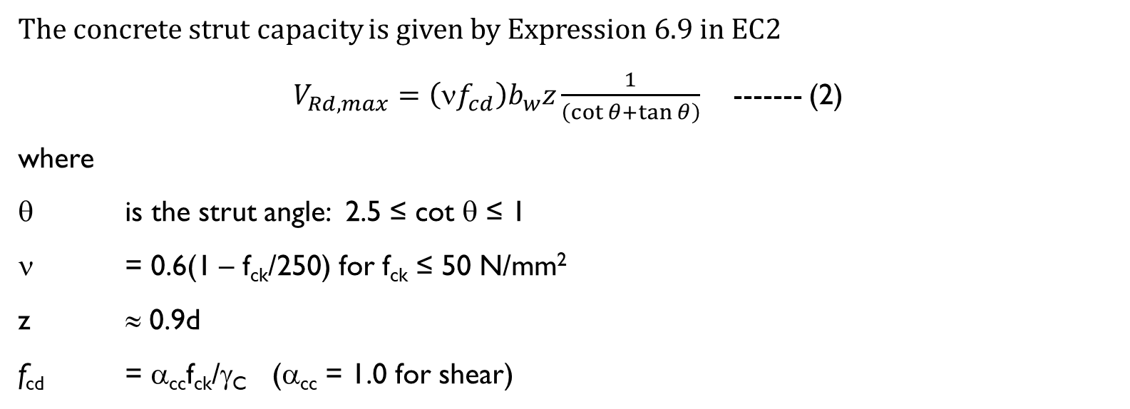
Concrete strut capacity, v_{Rd,max}
The concrete strut capacity is given by Expression 6.9 in EC2
$V_{Rd,max}=\left(\text{ν}f_{cd}\right)b_{w}z\frac{1}{\left(\cot{θ+\tan{θ}}\right)}$------- (2)
where
θ is the strut angle: 2.5 ≤ cot θ ≤ 1
ν = 0.6(1 – f_{ck}/250) for f_{ck} ≤ 50 N/mm²
z ≈ 0.9d
f_{cd} = α_{cc}f_{ck}/γ_{C} (α_{cc} = 1.0 for shear)

Slide 8
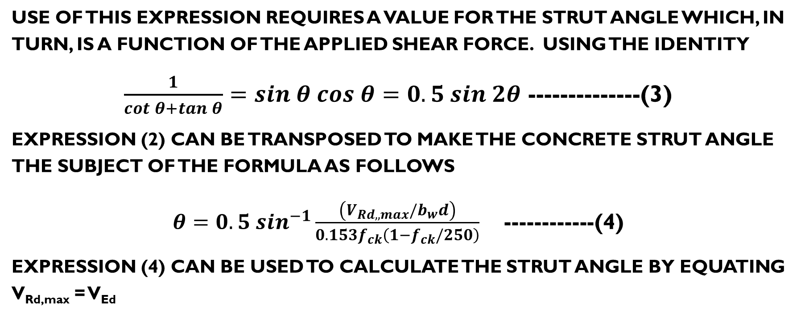
STRUT ANGLE
Use of this expression requires a value for the strut angle which, in turn, is a function of the applied shear force. Using the identity
$\frac{1}{cot θ+tan θ}=sin θ cos θ=0.5 sin 2θ$ --------------(3)
expression (2) can be transposed to make the concrete strut angle the subject of the formula as follows
$θ=0.5 \sin^{−1}\frac{\left(V_{Rd,,max}/b_{w}d\right)}{0.153f_{ck}\left(1−f_{ck}/250\right)}$------------(4)
Expression (4) can be used to calculate the strut angle by equating V_{Rd,max} = V_{Ed}

Slide 9
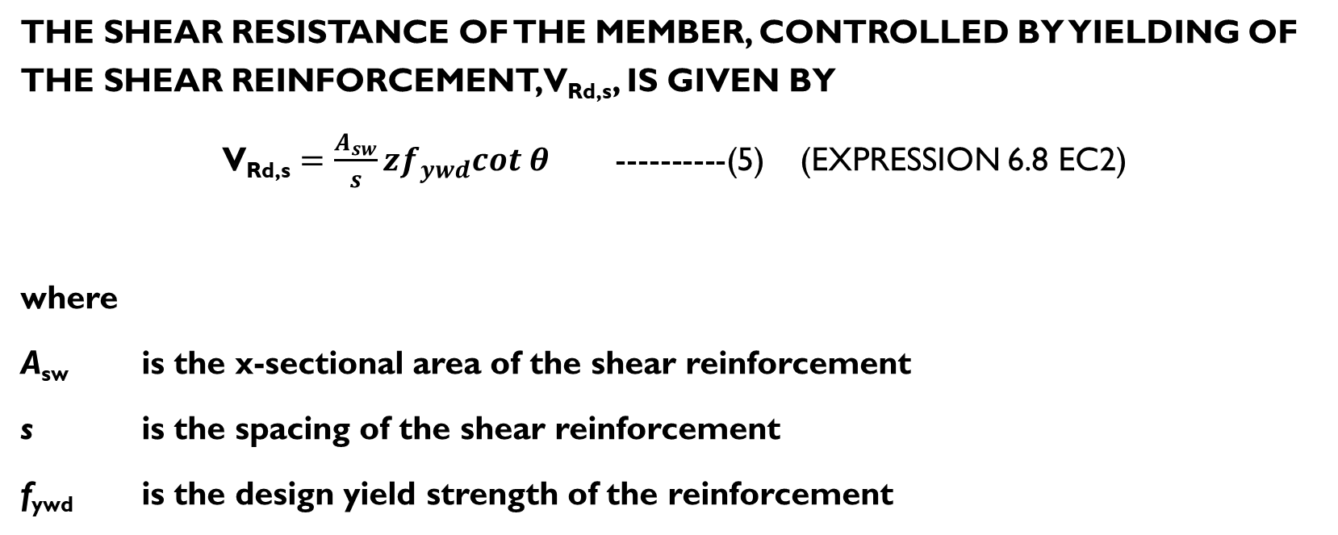
SHEAR RESISTANCE OF STIRRUPS
The shear resistance of the member, controlled by yielding of the shear reinforcement, V_{Rd,s}, is given by
V_{Rd,s} $=\frac{A_{sw}}{s}zf_{ywd}cot θ$ ----------(5) (EXPRESSION 6.8 EC2)
where
A_{sw} is the x-sectional area of the shear reinforcement
s is the spacing of the shear reinforcement
f_{ywd} is the design yield strength of the reinforcement

Slide 10
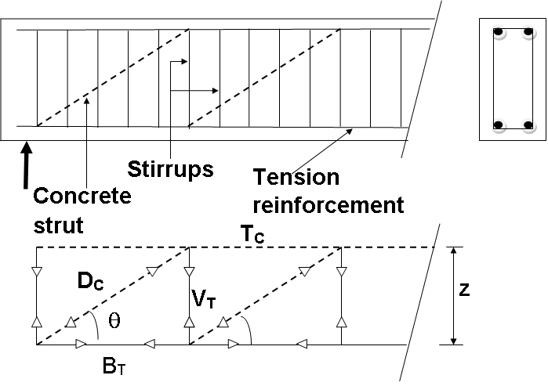
TRUSS ANALOGY

Slide 11
DESIGN PROCEDURE
The design process can be summarised as follows:
(i) Calculate the design shear force, V_{Ed}.
(ii) Determine the design shear resistance of the concrete, V_{Rd,c,} FROM (1)
(iii) If V_{Ed} < V_{Rd,c} shear reinforcement can be omitted except in beams where a minimum area of shear reinforcement must be provided (see below).

Slide 12
DESIGN PROCEDURE (cont’D)
(iv) If V_{Ed} > V_{Rd,c} all the shear force must be resisted by the shear reinforcement. Provided V_{Ed} < V_{Rd,max}, the area of shear reinforcement can be determined using expression (5). V_{Rd,max} is estimated from (2) assuming initially cot θ = 2.5. However, if the result is V_{Ed} > V_{Rd,max} a larger strut angle, θ, may be used. The maximum allowable value of θ is 45º (i.e. cot θ = 1). The actual value of the strut angle for a given design shear force, V_{Ed}, can be determined from (4) and used, in turn, to calculate the area of shear reinforcement from (5).
If the strut angle exceeds 45º, however, a deeper concrete section must be provided and steps (ii)-(iv) repeated.

Slide 13
Minimum shear reinforcement
Minimum reinforcement, ρ_{w}, should be provided in beams where V_{Ed} < V_{Rd,c} obtained from
ρ_{w} = A_{sw} / (sb_{w}sin α) ≥ ρ_{w,min} ------------(6)
where
A_{sw} is the area of shear reinforcement within length s
s is the spacing of the shear reinforcement
b_{w} is the breadth of the member
α = 90º for vertical stirrups ⇒ sin α = 1
ρ_{w,min} is the minimum area of shear reinforcement = (0.08√f_{ck})/f_{yk}------------(7)

Slide 14
Spacing of shear reinforcement (Cl. 9.2.2, EC2)
EC2 recommends that the maximum longitudinal spacing of shear reinforcement (s_{l,max}) should not exceed
s_{l,max} ≤ 0.75d(1 + cot α) -------(8)
where
α = 90º for vertical stirrups ⇒ cot α = 0

